Slide 1

Implementation of ANTI-CORRUPTION GLOBAL COMMITMENT
Deputy of Information and Data, Corruption Eradication Commission (KPK)
Mochamad Hadiyana
SEAPAC and DPR-RI Webinar, February 9th 2021
Notes:
Assalamualaikum Wr Wb,
The Honourable Dr. Fadli Zon MP, Chair of SEAPAC,
The Honourable Ahmad Bin Abdulla bin Zaid Al-Mahmoud MP, Chair of
GOPAC,
The Honourable Dr. Puan Maharani, Chair of the House of Representatives of the Republic of Indonesia,
And distinguished delegates from South East Asia Parliamentarians against
Corruption (SEAPAC),
Ladies and gentlemen,
Good morning.
On behalf of the Corruption Eradication Commission of the Republic of Indonesia, I would like to express my heartfelt gratitude to the South East Asia Parliamentarians against Corruption (SEAPAC) and the House of Representatives of the Republic of
Indonesia for the excellent preparations made for the webinar.

Slide 2

KPK AT A GLANCE
Notes:
Next slide please

Slide 3
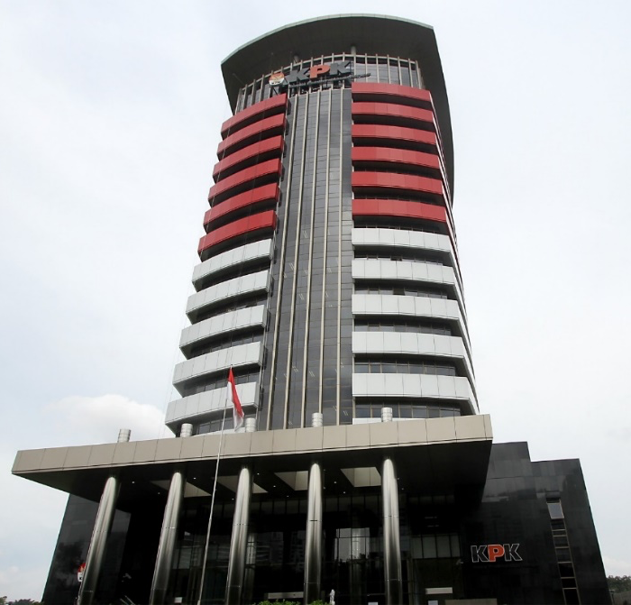
KPK Vision and Mission
Vision
Together with the people, decrease the level of corruption for better Indonesia
Mission
Enhance preventive measure through system improvements
Enhance preventive measure through comprehensive anti-corruption education
Eradicate corruption effectively, accountable, professional, and in line with the law
Enhance accountability, professionalism, and integrity of the Corruption Eradication Commission in the implementation of its duties and authority
Notes:
Excellencies,
Fighting corruption whether through preventive or enforcement measures is not easy, and the role of effective anti-corruption bodies is paramount to tackle this extraordinary crime.
Indonesian Corruption Eradication Commission, also known as Komisi Pemberantasan Korupsi or the KPK, was established in 2002. The Commission’s mandate is to eradicate corruption through law enforcement and prevention measures.
Our vision is together with the people, decrease the level of corruption for better Indonesia. We undertake our missions namely to prevent corruption through system improvement and education as well as to eradicate corruption in effective and accountable manners.

Slide 4
KPK Duties
Based on Law No.19/2019
Preventive measure to prevent corruption crime
Coordination with authorities in charge of corruption eradication and public services
Monitor the administration of state governance
Supervision of Law Enforcement Agencies in corruption cases matter
Pre-investigation, investigation, and prosecution of corruption cases
Implement Judge orders and Court verdict that has execution power
Notes:
The KPK has six main duties based on Law number 19 of 2019. We are tasked to prevent corruption, coordinate and supervise anti-corruption measures by other agencies, monitor the state administration, investigate and prosecute corruption offences and also execute the court verdict

Slide 5
Corruption Eradication Strategy
PUBLIC EDUCATION
Anti-corruption education in all level and types of education (from kindergarten to universities)
Anti-corruption education for public officials and political parties
PREVENTION
Asset declaration and gratification management, etc
LAW ENFORCEMENT
To create a deterrent effect
Goal: people afraid to commit corruption
Anti-corruption education for all private sectors, including state owned companies and regional government owned companies
Research and development on the government bureaucracy and administrative system to address system loophole and decrease the risk of corruption
National Strategy on Corruption prevention (Stranas PK)
Professional, fair and accountable law enforcement with respect to human rights
Goal: people do not want to commit corruption
Goal: people can not commit corruption
In line with law and relevant regulation
Notes:
Under the leadership of our current commissioners, the Commission now has 3 anti-corruption strategies, namely public education, along with corruption prevention and law enforcement.

Slide 6
INDONESIA
GLOBAL COMMITMENT IMPLEMENTATION
KPK as Focal Point
Notes:
I would like to take this opportunity to present KPK’S Role on Anti-Corruption Global Commitment. Next slide please.

Slide 7


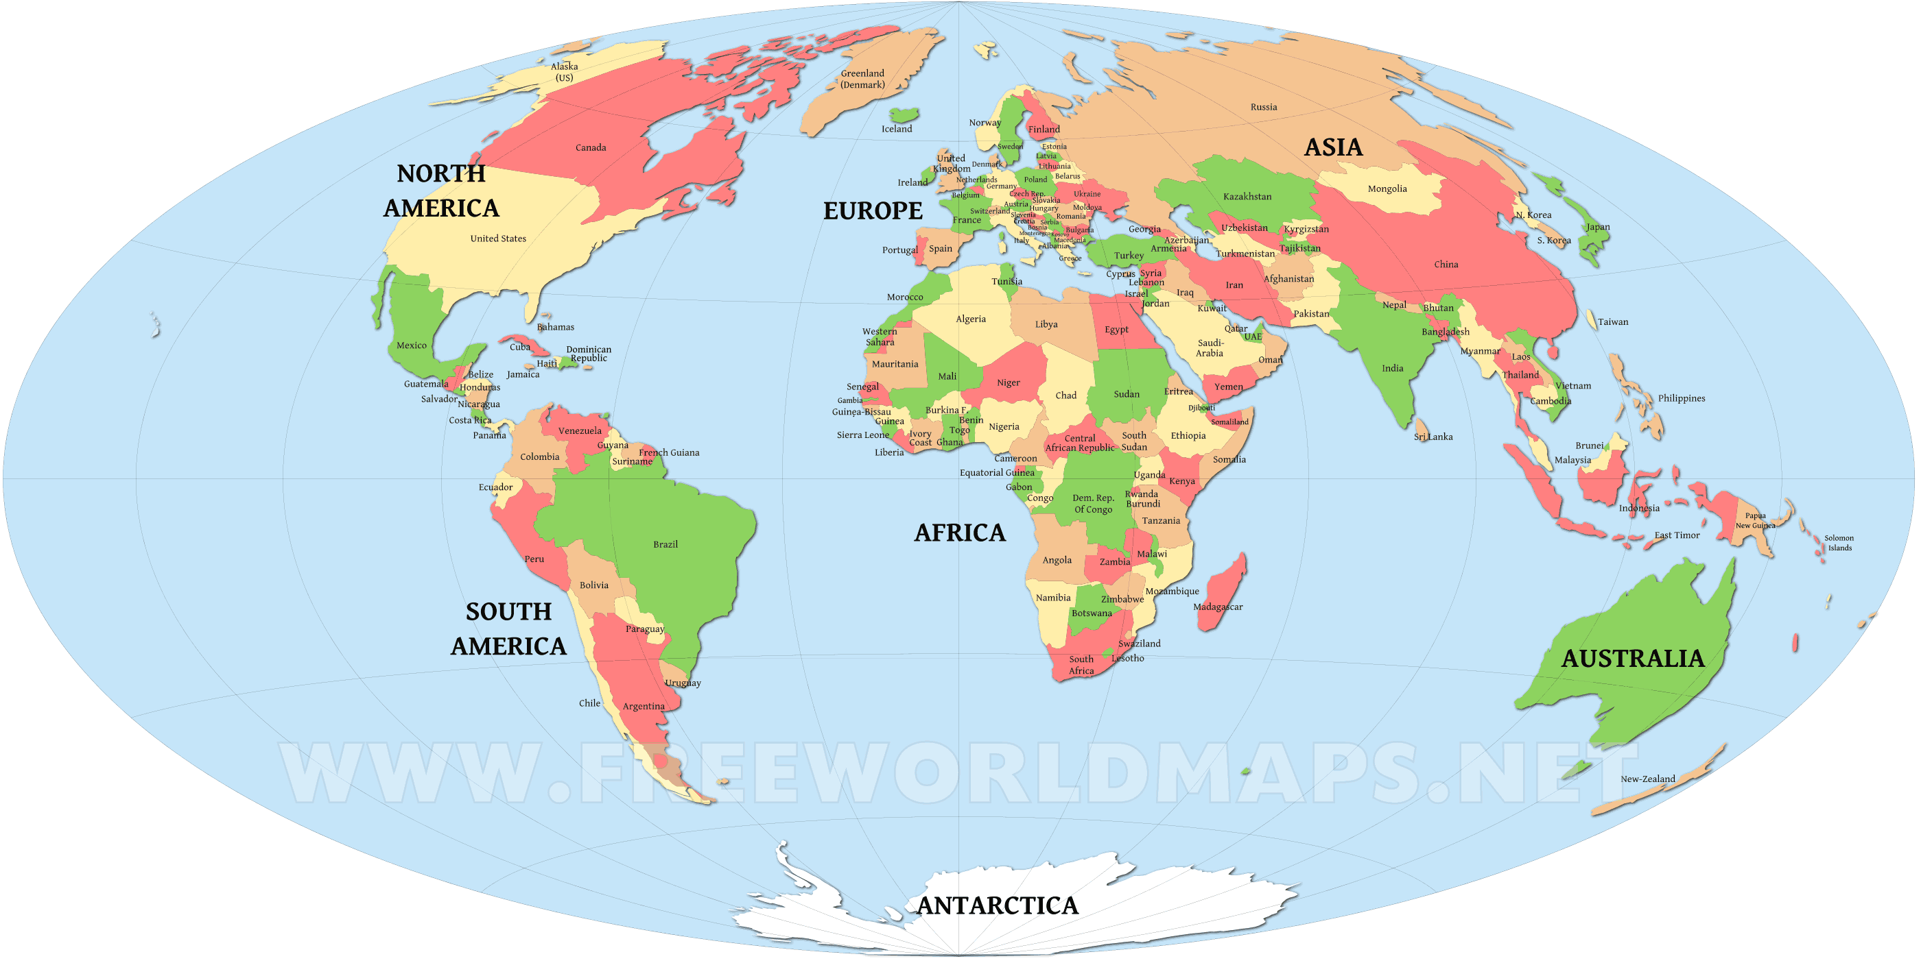


United Nations Against Corruption (UNCAC)
G20 Anti Corruption Working Group
MULTILATERAL
COOPERATION
2021
Prevention Measures
Asset Recovery
Technical Assistance
Criminalization and Law Enforcement
International Cooperation
anti-bribery
fighting corruption in the public and private sectors,
preventing access of corrupt persons to global financial systems,
denial of entry, extradition and asset recovery
2020
187 State Parties
Indonesia will be G20 Chair in 2022
APEC Anti Corruption and Transparency Working Group
ASEAN Parties Against Corruption (ASEANPAC)
Other International Forum
21
Santiago commitment to fight corruption and ensure transparency
APEC course of action on fighting corruption
APEC transparency standards
Beijing declaration on fighting corruption
Collaborative efforts against corruption
Capacity and institutional building
Economies
10
ACA from ASEAN Countries
IACC, ADB OECD Anti Corruption Initiative, International Anti Corruption Academy, etc
Notes:
Combating corruption also calls for international cooperation. Technological advancement and globalization have facilitated cross border corrupt practices. It is important to foster strategic partnership with other law enforcement agencies not only in the regions but also globally.
As a State Party to both the United Nations Convention Against Corruption (UNCAC) and United Nations Convention on Transnational Organised Crime (UNTOC), Indonesia plays an active role internationally in enforcement cooperation, knowledge sharing and information exchange, and advocacy of international policies and standards.
Indonesia’s has been participating in several networks such as the working group and expert meeting on asset recovery and international cooperation under the UNCAC, APEC-Anti-Corruption and Transparency Networks (APEC-NET), Anti-Corruption Initiative for Asia-Pacific, ASEAN Parties Against Corruption and the Economic Crime Agencies Network (ECAN).

Slide 8
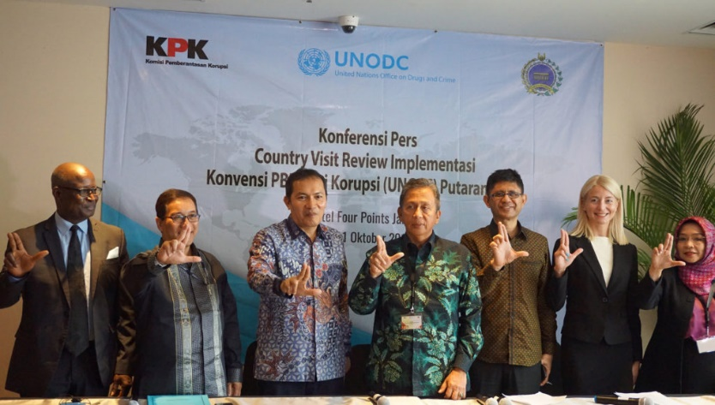
UNCAC Implementation Review
Indonesia has completed the 1st cycle and 2nd cycle of implementation review.
Resulted in 53 Recommendations from the cycles
KPK as Indonesian national focal point for UNCAC will continue to address the challenges of the fight against corruption and improve Indonesia’s compliance to the UNCAC recommendations.
We are committed to taking and promoting a multi-stakeholder approach to prevent and combat corruption by strengthening our partnerships, including with parliamentarians.
Notes:
Indonesia has completed the 1st and 2nd cycle of UNCAC implementation review. The review resulted in 53 recommendations. We commit to taking and promoting a multi-stakeholder approach to preventing and combating corruption by strengthening our partnerships, including with parliamentarians.

Slide 9
UNCAC RECOMMENDATIONS FOR ACTION
Notes:
There are 53 recommendations for actions by the UNCAC implementation reviews:
19 recommendations on criminalization and law enforcement;
13 recommendations on international cooperation;
14 recommendations on prevention; and
7 recommendations on asset recovery

Slide 10
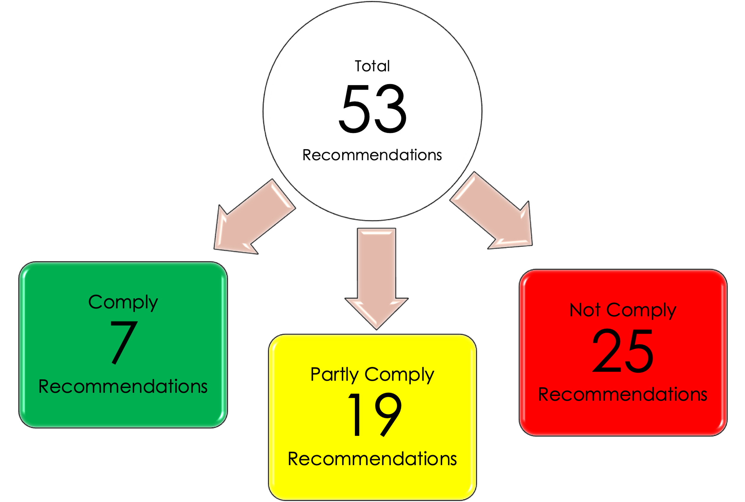
Indonesia’s Compliance on UNCAC
Notes:
I would like to highlight the updates regarding Indonesia’s Compliance on UNCAC.
There are 2 recommendations that can’t be fulfilled because they aren’t in line with our domestic law;
7 recommendations that we are fully comply;
19 recommendations that we are partly comply; and
25 recommendations that we are not yet comply.
These numbers represent that eradicating corruption requires strong commitment from multi stakeholders.

Slide 11
Compliance Overview
Protection of reporting persons
Information-gathering by FIU for money laundering prevention
Amendment on National Strategy of Corruption Prevention
Improvement on Beneficial Ownership legal framework and implementation
Mutual Legal Assistance (MLA) request requirement
COMPLY
7
Recommendations
Notes:
Moving on, Indonesia has reported an excellence progress in the area of protection of reporting persons, money laundering prevention, National Strategy of Corruption Prevention, Beneficial Ownership transparency and Mutual Legal Assistance (MLA).
I would like also to add information that from 2013 to 2020, there have been 175 incoming MLA requests in total. During this period, Indonesia received 7 MLA requests related to corruption offences and 11 MLA requests on Money Laundering Crimes. None of these requests have been refused by the Indonesian authorities to date.

Slide 12
Compliance Overview
Corruption prevention measure:
- National strategy on corruption prevention
- Measure on private sector corruption
- Measure on judiciary integrity
- Conflict of interest handling
- Public information transparency
- Procurement mechanism
- Money laundering prevention
- Public official code of conduct
Asset recovery measures
- Assets Management
- Assets freeze/seize handling coordination
- Assets confiscation request mechanism (from foreign country)
Corruption case handling
- Bank secrecy
- Justice collaborator
PARTLY COMPLY
19
Recommendations
Notes:
During the UNCAC implementation review, reviewers also acknowledge that Indonesia has established several anti-corruption measures that shown considerable progress in the area of corruption prevention, asset recovery and corruption case handling, particularly on bank secrecy and justice collaborator.

Slide 13
Compliance Overview
Revision on Indonesian Anti-Corruption Law:
- Criminalization of offences including foreign bribery, illicit enrichment, trading in influence, corruption in the private sector
- Remove the reference to state loss
- Corruption handling mechanism
Revision of Penal Code (KUHP)
- Case period limitation
Revision on MLA Law
- MLA mechanism and effectiveness
New Law & regulation:
- Law on Extradition
- Law on Asset recovery
- Law on Public Procurement
- Regulation on financial report standard & non-deductibility expense on corruption conduct
NOT COMPLY YET
25
Recommendations
Notes:
However, amendments of Anti-Corruption Law, Mutual Legal Assistance Law, Penal Code as well as the establishment of Extradition Law and Asset Recovery Law, are a few outstanding recommendations that require strong commitment and continued efforts from the Government of Indonesia and Indonesian parliament.
Under the UNCAC obligations, for example, Indonesia is required to criminalize foreign bribery, illicit enrichment, trading in influence and corruption in the private sector.

Slide 14

UNGASS 2021
On 2- 4 June 2021, the first-ever UN General Assembly Special Session (UNGASS) focused on corruption will be held. The UNGASS was officially set for these dates in UN General Assembly resolution 74/568 on 31 August 2020.
The UNGASS provides an opportunity to shape the global anti-corruption agenda for the next decade – by advancing bold and innovative approaches, scaling best practices and developing new standards and mechanisms.
Notes:
On 2 to 4 June 2021, the first-ever UN General Assembly Special Session (UNGASS) focused on corruption will be held. The UNGASS was officially set for these dates in UN General Assembly resolution 74/568 on 31 August 2020. The UNGASS provides an opportunity to shape the global anti-corruption agenda for the next decade – by advancing bold and innovative approaches, scaling best practices and developing new standards and mechanisms.

Slide 15
UNGASS momentum & The Role of Parliamentarians
Each of UNCAC State Parties should individually and collectively pursue a comprehensive and holistic anti-corruption agenda.
UNGASS 2021 provides an opportunity for the State Parties to reiterate their commitments in combating corruption, both in national and international level, to achieve the common vision of a world free of corruption.
Political Declaration that will be adopted during the UNGASS represents the enduring commitment of State Parties to build a culture that rejects corruption in all of its forms.
Parliament has an important role in improving and strengthening national legal frameworks of anti-corruption, in line with international obligations under the UNCAC.
Notes:
UNGASS 2021 provides an opportunity for the State Parties to reiterate their commitments in combating corruption, both in national and international level, to achieve the common vision of a world free of corruption.
Parliament has an important role to improve and strengthen national legal frameworks on anti-corruption, in line with international obligations under the UNCAC.

Slide 16


THANK YOU
Notes:
Excellencies,
To conclude my presentation, I would like to share our belief that it is timely for the ASEAN countries to continue to seek concrete solutions in addressing corruption. We look forward for the fruitful discussion. Thank you.

